Slide 1
CS4710: Artificial Intelligence Intro to Machine Learning
Intelligent beings (e.g., humans) are excellent at learning. How can we try to program systems to learn interesting new things?

Slide 2
Supervised Learning: Regression

Slide 3

Intro to Regression
Regression is a statistical method for learning and predicting classifications
Works by minimizing a cost function over all data points
Can be extended in several important ways
Is a very good, general, supervised learning technique

Slide 4
Example: Predicting NBA Stats
Name | Pts College | Pts in NBA
Joe Harris | 12.6 | 2.5
Sean Singletary | 16.9 | 2.4
Kevin Durant | 25.8 | 25.4
Tony Bennett | 19.4 | 3.5
Chris Paul | 15.0 | 18.9
Anthony Davis | 14.2 | 24.7
Suppose we know the number of points several NBA players scored in college and currently score in the NBA.
We want to predict how many points current college players will score in the NBA
* Yes, this model is too simplistic so far

Slide 5
Regression Process
Training Examples
Regression Algorithm
Features:
Avg. Points in College
Prediction:
Avg. Points in NBA
H(x)
H(x) is called the hypothesis function
This inputs a data point and outputs a prediction output
Regression algorithm finds the best hypothesis function

Slide 6
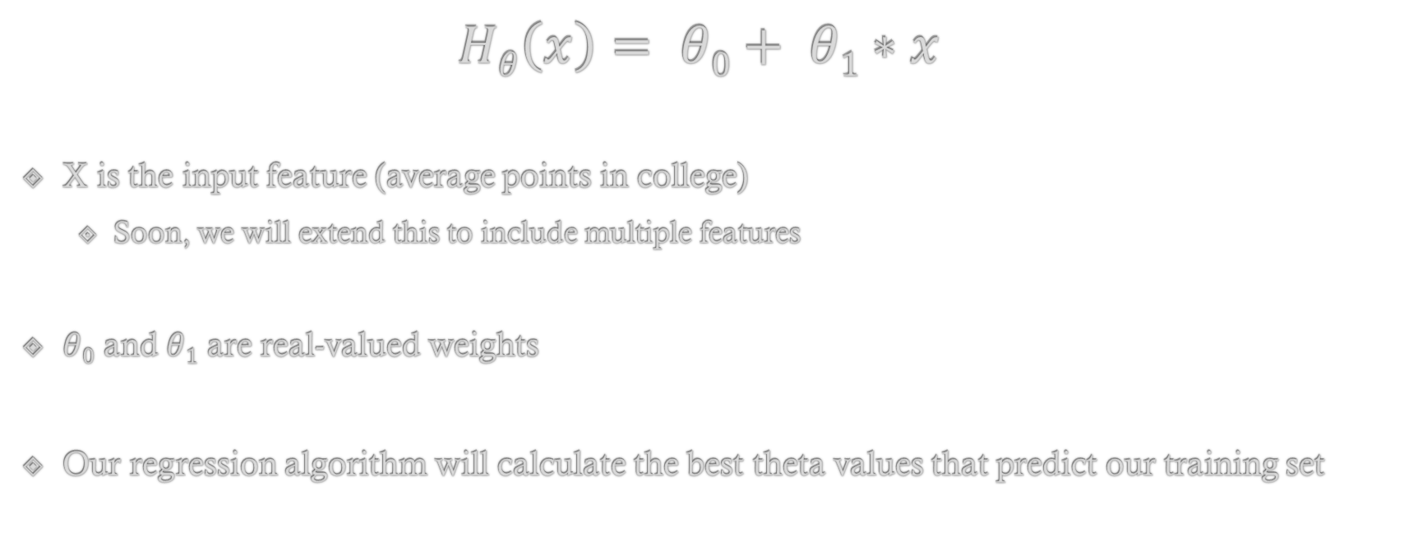
Hypothesis Function for Linear Regression
$$Hθ\left(x\right)= θ0+ θ1∗x$$
X is the input feature (average points in college)
Soon, we will extend this to include multiple features
$θ0$ and $θ1$ are real-valued weights
Our regression algorithm will calculate the best theta values that predict our training set

Slide 7
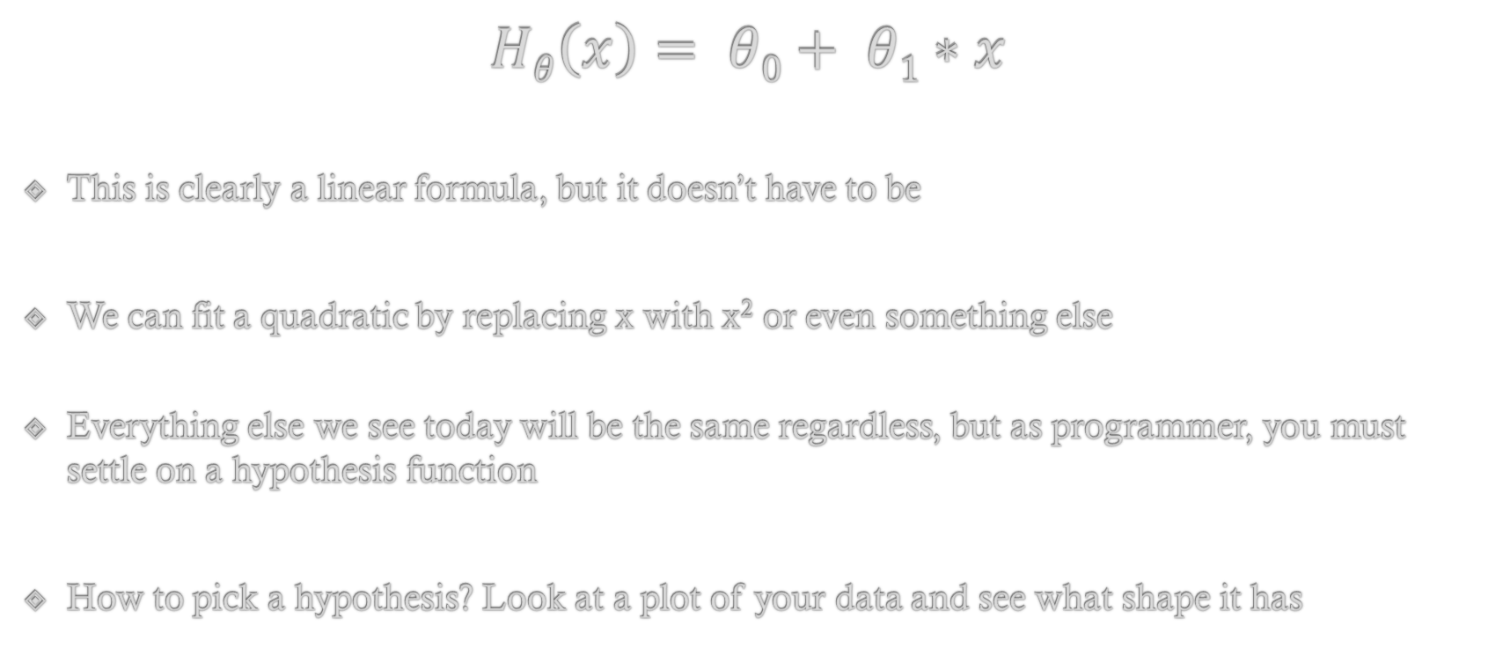
Hypothesis Function
$$Hθ\left(x\right)= θ0+ θ1∗x$$
This is clearly a linear formula, but it doesn’t have to be
We can fit a quadratic by replacing x with x² or even something else
Everything else we see today will be the same regardless, but as programmer, you must settle on a hypothesis function
How to pick a hypothesis? Look at a plot of your data and see what shape it has

Slide 8
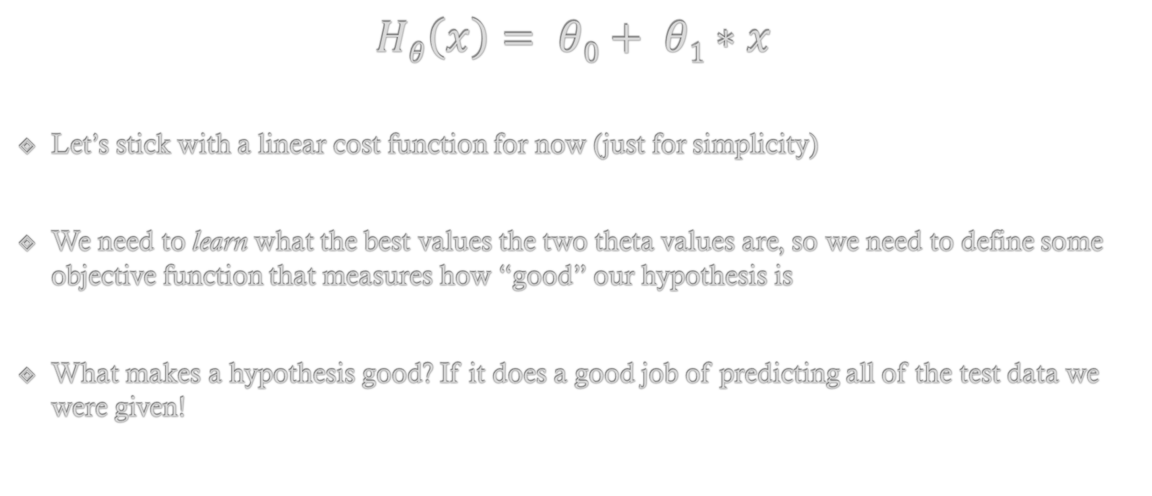
Hypothesis Function
$$Hθ\left(x\right)= θ0+ θ1∗x$$
Let’s stick with a linear cost function for now (just for simplicity)
We need to learn what the best values the two theta values are, so we need to define some objective function that measures how “good” our hypothesis is
What makes a hypothesis good? If it does a good job of predicting all of the test data we were given!

Slide 9
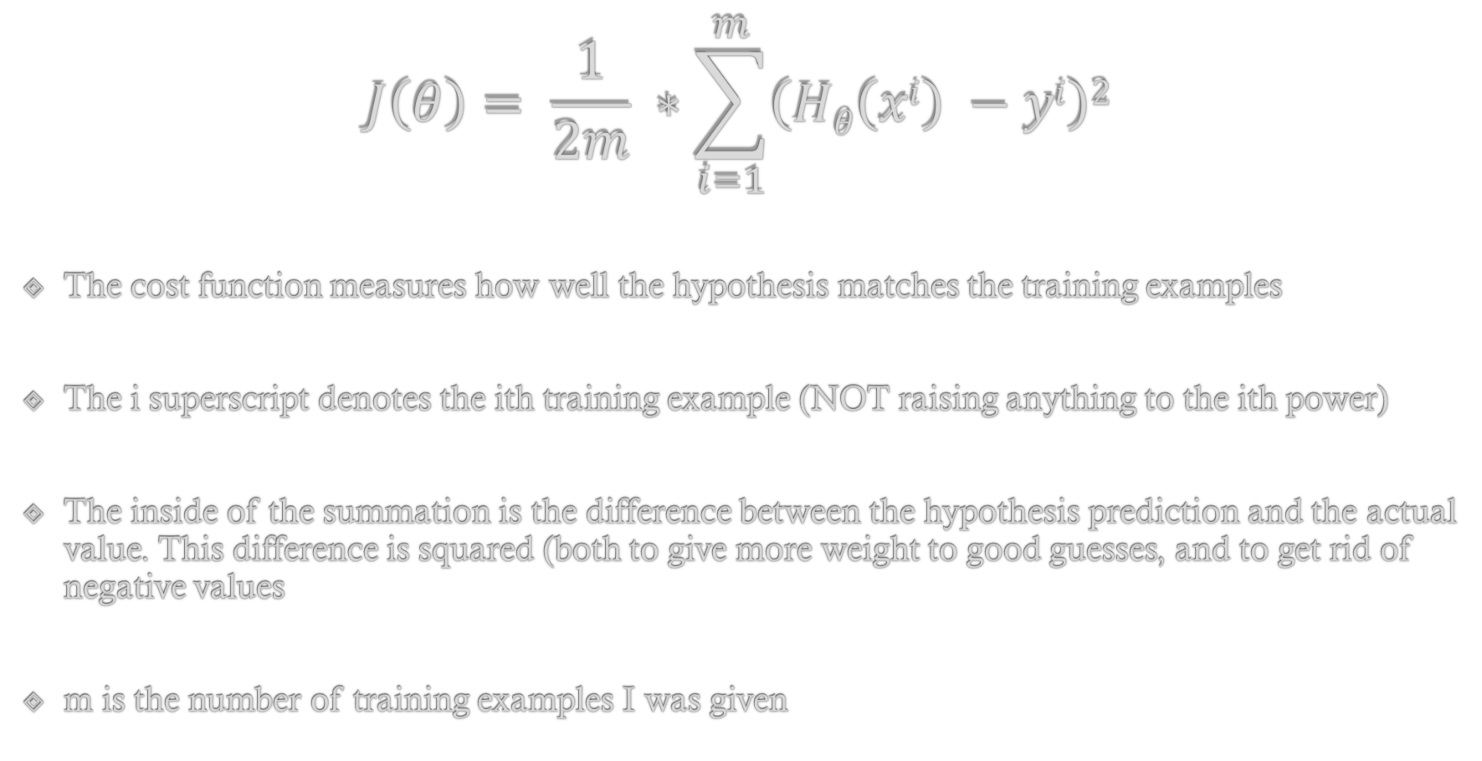
Cost Function
$$J\left(θ\right)= \frac{1}{2m} ∗\sum_{i=1}^{m}{\left(Hθ\left(xi\right) −yi\right)2}$$
The cost function measures how well the hypothesis matches the training examples
The i superscript denotes the ith training example (NOT raising anything to the ith power)
The inside of the summation is the difference between the hypothesis prediction and the actual value. This difference is squared (both to give more weight to good guesses, and to get rid of negative values
m is the number of training examples I was given

Slide 10
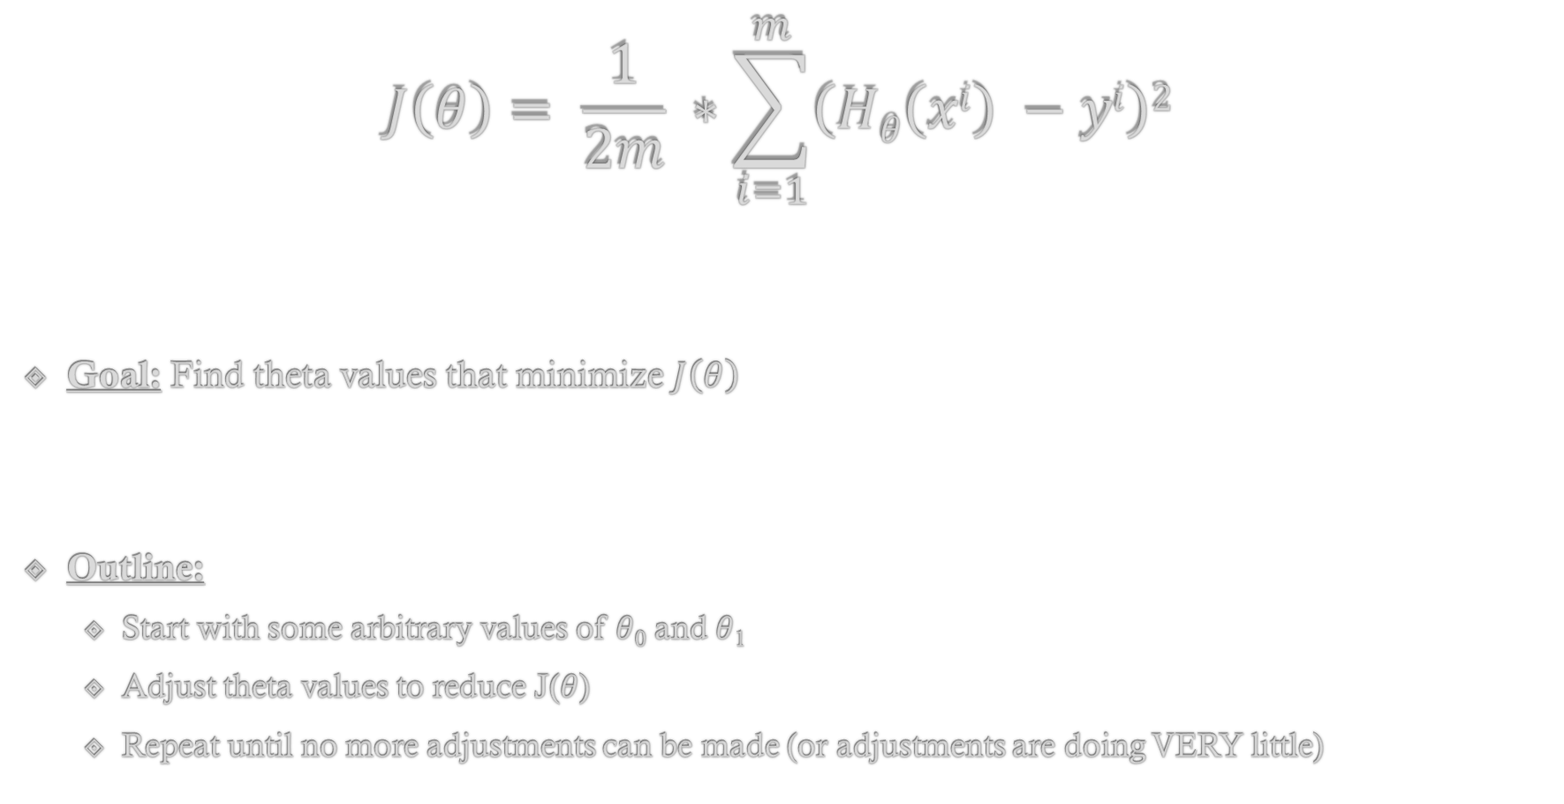
Gradient Descent Learning Algorithm
$$J\left(θ\right)= \frac{1}{2m} ∗\sum_{i=1}^{m}{\left(Hθ\left(xi\right) −yi\right)2}$$
Goal: Find theta values that minimize $J\left(θ\right)$
Outline:
Start with some arbitrary values of $θ$₀ and $θ$₁
Adjust theta values to reduce J($θ$)
Repeat until no more adjustments can be made (or adjustments are doing VERY little)

Slide 11
Gradient Descent Learning Algorithm
Problem: How do I know how to adjust each theta value so my overall cost function goes down?
Remember, I want to adjust ALL of the theta values at once.
So…it’s not really an option to try different values and see what happens. If we have more features (which we will in a moment), then this will be way too slow.
Solution: let’s differentiate the cost function!

Slide 12
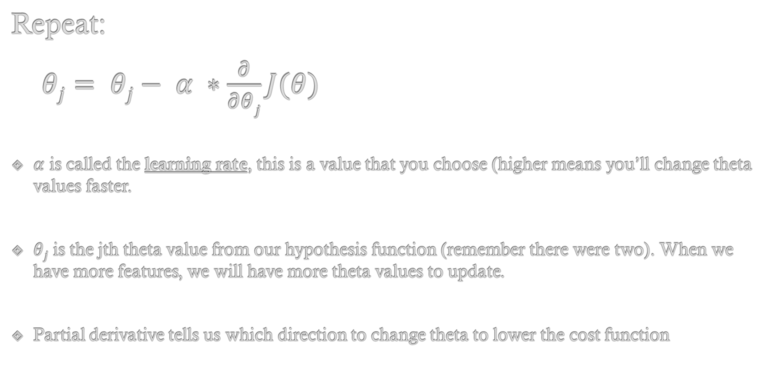
Gradient Descent Learning Algorithm
Repeat:
$θj= θj− α ∗\frac{∂}{∂θj}J(θ)$
$α$ is called the learning rate, this is a value that you choose (higher means you’ll change theta values faster.
$θj$ is the jth theta value from our hypothesis function (remember there were two). When we have more features, we will have more theta values to update.
Partial derivative tells us which direction to change theta to lower the cost function

Slide 13
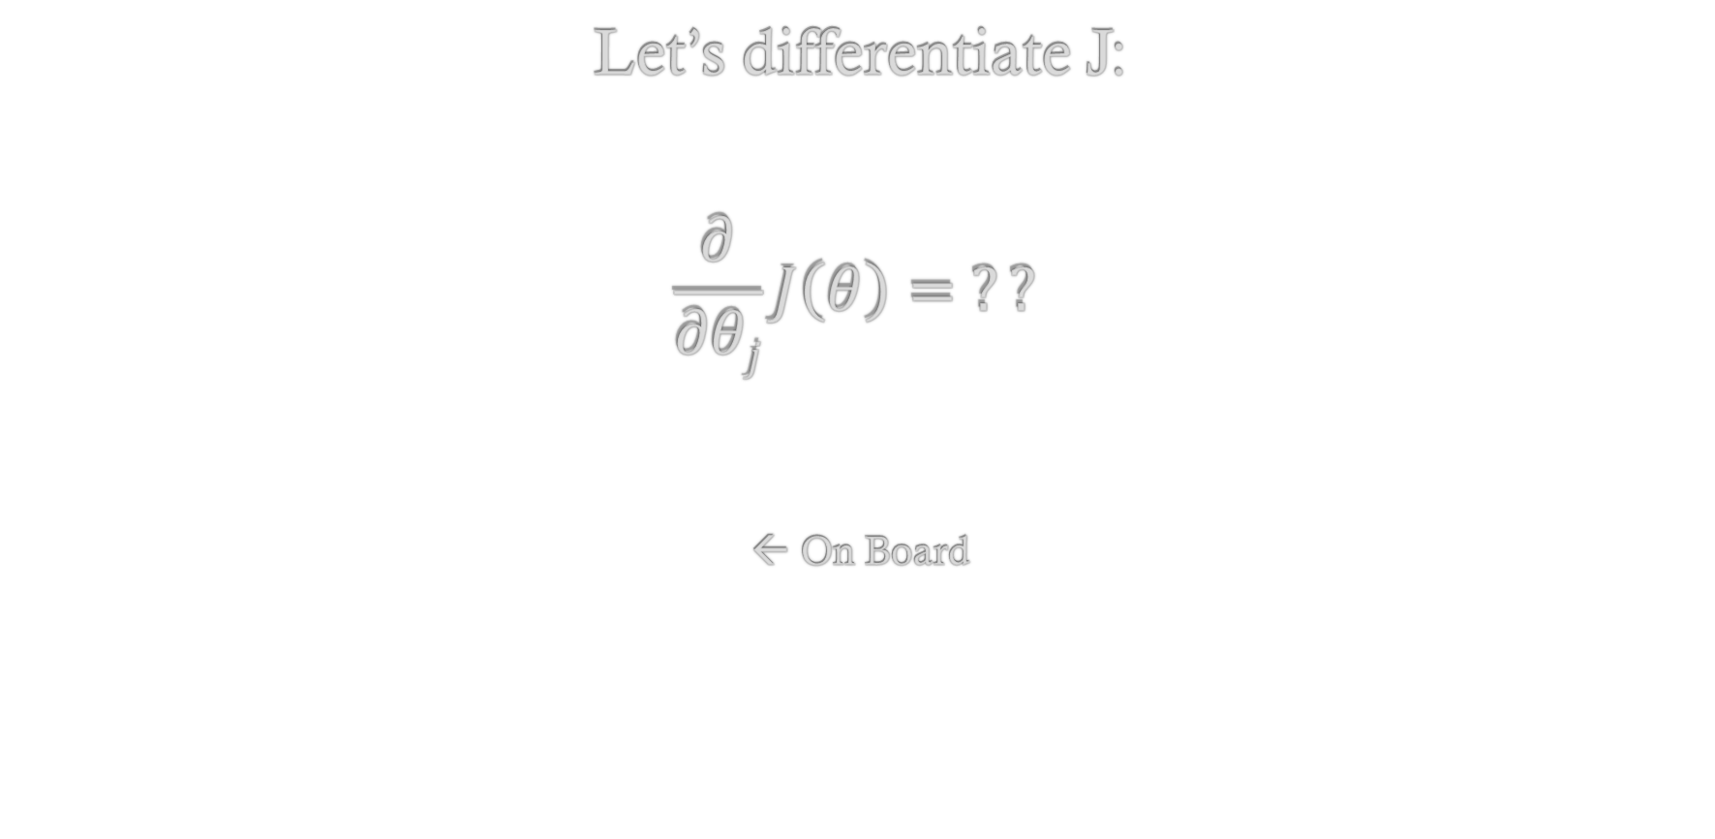
Gradient Descent Learning Algorithm
Let’s differentiate J:
$$\frac{∂}{∂θj}J\left(θ\right)= ??$$
← On Board

Slide 14
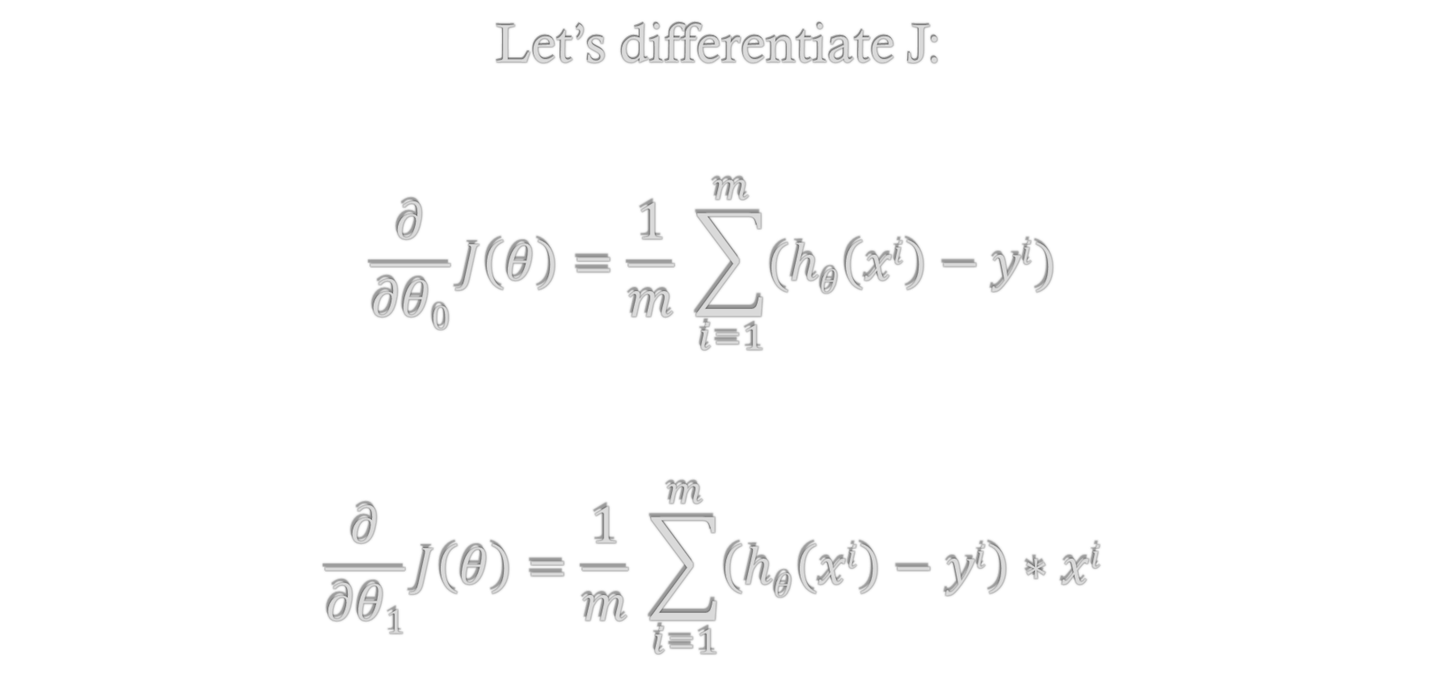
Gradient Descent Learning Algorithm
Let’s differentiate J:
$$\frac{∂}{∂θ0}J\left(θ\right)=\frac{1}{m} \sum_{i=1}^{m}{(hθ\left(xi\right)−yi)}$$
$$\frac{∂}{∂θ1}J\left(θ\right)=\frac{1}{m} \sum_{i=1}^{m}{\left(hθ\left(xi\right)−yi\right)∗xi}$$

Slide 15
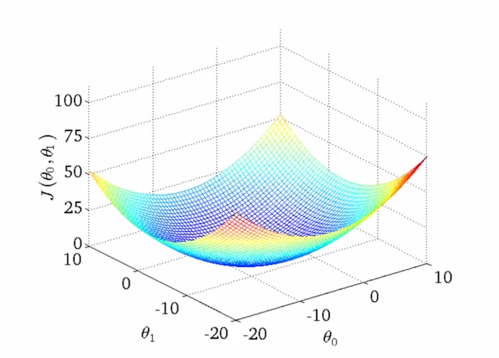
Gradient Descent: Local Minima?

Slide 16
Regression Process
Training Examples
Regression Algorithm
Features:
Avg. Points in College
Prediction:
Avg. Points in NBA
H(x)
H(x) is called the hypothesis function
This inputs a data point and outputs a prediction output
Regression algorithm finds the best hypothesis function

Slide 17
Supervised Learning: Regression
Multiple variables, polynomial regression, feature scaling, and other slight adjustments to linear regression

Slide 18
Example: Predicting NBA Stats
Name | Pts College | Steals/Game | FG% | 3pt% | Pts in NBA
Joe Harris | 12.6 | 0.9 | .445 | .407 | 2.5
Sean Singletary | 16.9 | 1.6 | .406 | .362 | 2.4
Kevin Durant | 25.8 | 1.9 | .473 | .404 | 25.4
Tony Bennett | 19.4 | 1.4 | .528 | .497 | 3.5
Chris Paul | 15.0 | 2.5 | .472 | .470 | 18.9
Anthony Davis | 14.2 | 1.4 | .623 | .150 | 24.7
Our previous data set wasn’t quite as reasonable. Don’t we want more data?
Sure! So what if we had several features for each player, could we more accurately predict NBA performance? Probably!

Slide 19
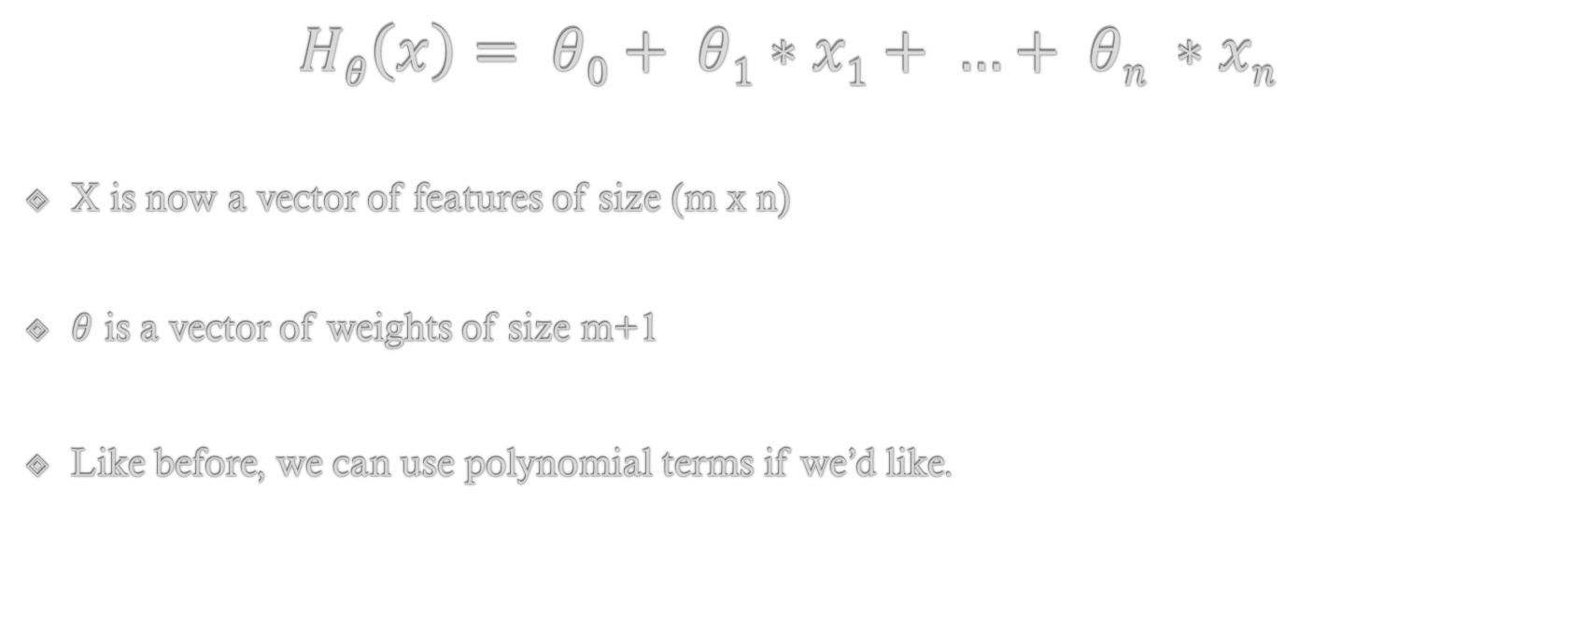
Hypothesis Function: Multiple Features
$$Hθ\left(x\right)= θ0+ θ1∗x1+ …+ θn ∗xn$$
X is now a vector of features of size (m x n)
$θ$ is a vector of weights of size m+1
Like before, we can use polynomial terms if we’d like.

Slide 20
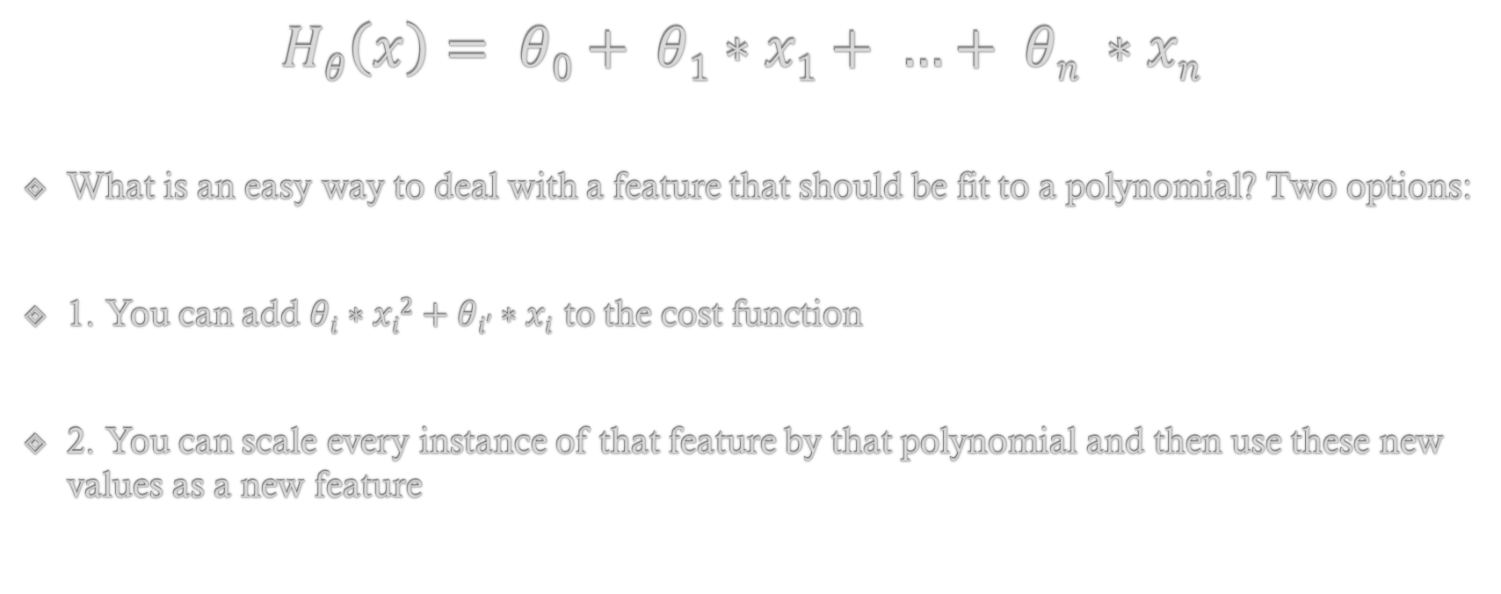
Hypothesis Function: Polynomial Terms
$$Hθ\left(x\right)= θ0+ θ1∗x1+ …+ θn ∗xn$$
What is an easy way to deal with a feature that should be fit to a polynomial? Two options:
1. You can add $θi∗xi2+θi′∗xi$ to the cost function
2. You can scale every instance of that feature by that polynomial and then use these new values as a new feature

Slide 21
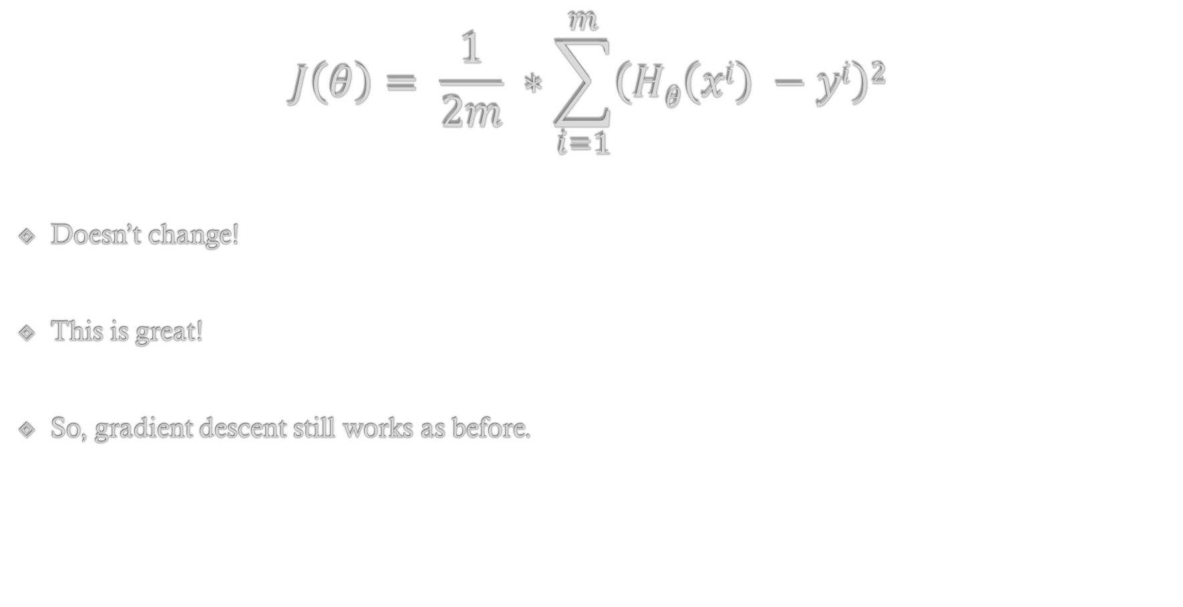
Cost Function
$$J\left(θ\right)= \frac{1}{2m} ∗\sum_{i=1}^{m}{\left(Hθ\left(xi\right) −yi\right)2}$$
Doesn’t change!
This is great!
So, gradient descent still works as before.

Slide 22
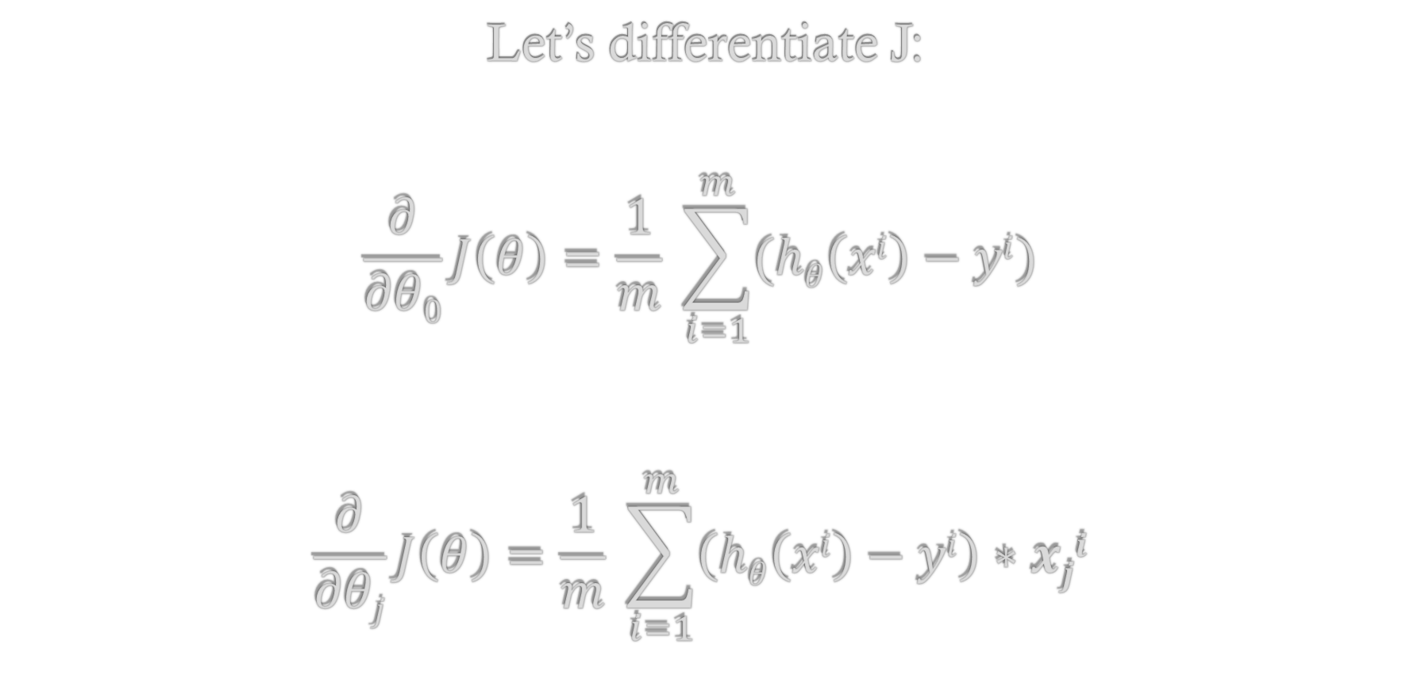
Gradient Descent Learning Algorithm
Let’s differentiate J:
$$\frac{∂}{∂θ0}J\left(θ\right)=\frac{1}{m} \sum_{i=1}^{m}{(hθ\left(xi\right)−yi)}$$
$$\frac{∂}{∂θj}J\left(θ\right)=\frac{1}{m} \sum_{i=1}^{m}{\left(hθ\left(xi\right)−yi\right)∗xji}$$

Slide 23
Supervised Learning: Regression
The normal equation

Slide 24
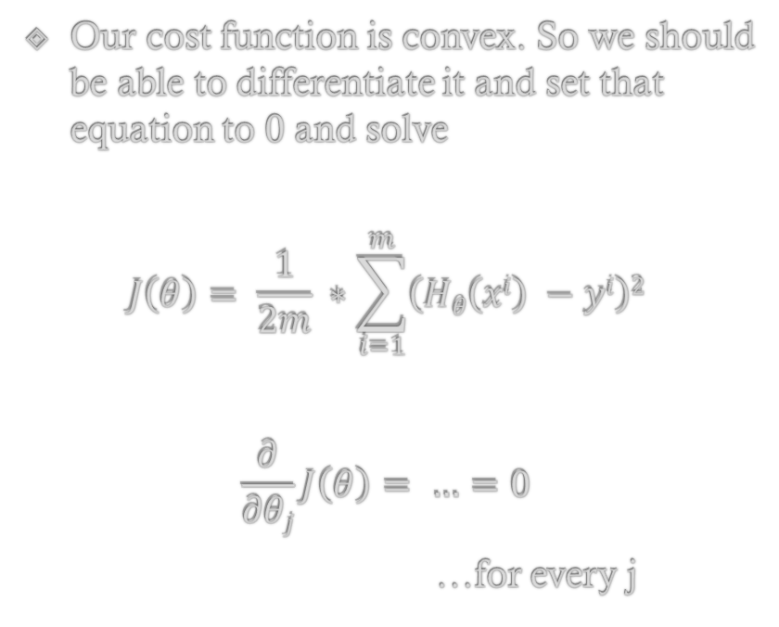
The Normal Equation
Problem (ish):
Gradient descent takes many steps to converge
Might take a while
Might have to tweak alpha and other parameters to get good performance
Our cost function is convex. So we should be able to differentiate it and set that equation to 0 and solve
$$J\left(θ\right)= \frac{1}{2m} ∗\sum_{i=1}^{m}{\left(Hθ\left(xi\right) −yi\right)2}$$
$$\frac{∂}{∂θj}J\left(θ\right)= …=0$$
…for every j

Slide 25
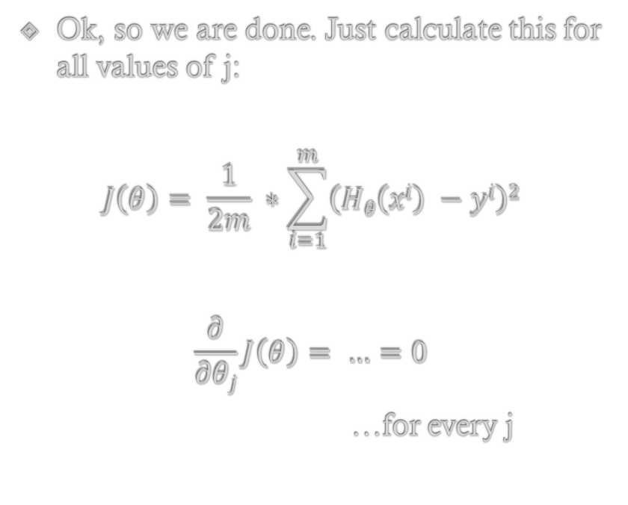
The Normal Equation
Ok, so we are done. Just calculate this for all values of j:
$$J\left(θ\right)= \frac{1}{2m} ∗\sum_{i=1}^{m}{\left(Hθ\left(xi\right) −yi\right)2}$$
$$\frac{∂}{∂θj}J\left(θ\right)= …=0$$
…for every j

Slide 26
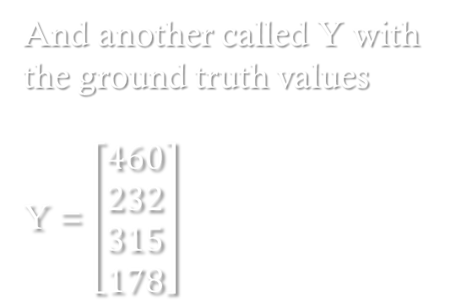
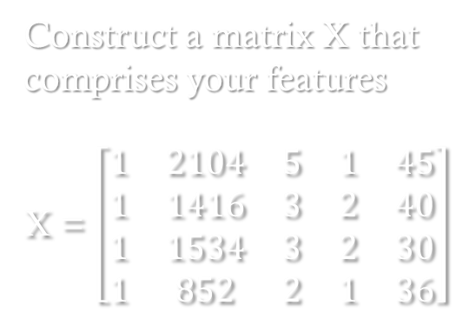
The Normal Equation
Ok, how do we actually do this. Turns out there is a really easy way!
Construct a matrix X that comprises your features
X = $\left[\begin{matrix}1 & 2104 & 5 & 1 & 45 \\ 1 & 1416 & 3 & 2 & 40 \\ 1 & 1534 & 3 & 2 & 30 \\ 1 & 852 & 2 & 1 & 36\end{matrix}\right]$
And another called Y with the ground truth values
Y = $\left[\begin{matrix}460 \\ 232 \\ 315 \\ 178\end{matrix}\right]$

Slide 27

The Normal Equation
Ok, how do we actually do this. Turns out there is a really easy way!
Construct a matrix X that comprises your features
X = $\left[\begin{matrix}1 & 2104 & 5 & 1 & 45 \\ 1 & 1416 & 3 & 2 & 40 \\ 1 & 1534 & 3 & 2 & 30 \\ 1 & 852 & 2 & 1 & 36\end{matrix}\right]$
And another called Y with the ground truth values
Y = $\left[\begin{matrix}460 \\ 232 \\ 315 \\ 178\end{matrix}\right]$
Fortunately, the vector containing the theta values for your fitted hypothesis function can be computer directly by:
$$θ=\left(XTX\right)−1 ∗XTY$$

Slide 28

The Normal Equation
Fortunately, the vector containing the theta values for your fitted hypothesis function can be computer directly by:
$$θ=\left(XTX\right)−1 ∗XTY$$
You may need a matrix library (or something like matlab) to make this easy.

Slide 29
Gradient Descent vs. Normal Equation
Works no matter what (logistic regression and other types)
Is reasonably fast, guaranteed to converge
Need to choose alpha (often is slow and needs to be adjusted a couple times
Needs to iterate, which often isn’t instantaneous
Great for the regressions we’ve seen so far
Directly computes minimum theta values for our hypothesis function
Easy to implement
Doesn’t work for all regression techniques
VERY slow if n gets large (but admittedly, n has to be quite big…10^5 or so)

Slide 30
Logistic Regression

Slide 31
Linear Regression vs. Logistic Regression
Typically used when the ground truth contains continuous values
Used for classification problems where the ground truth takes the form of discrete values
Very widely used in practice
Examples:
Email spam/not spam
Tumor malignant or benign
Etc…

Slide 32
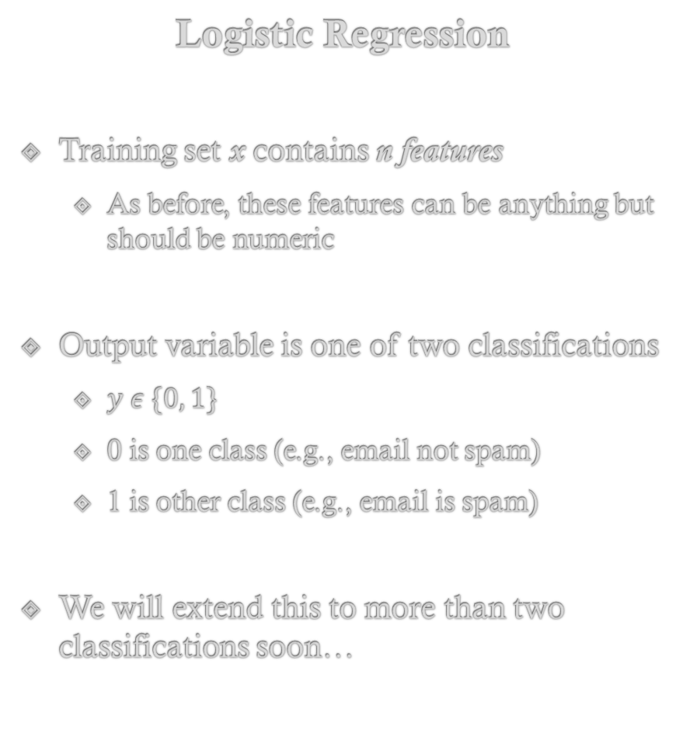
Logistic Regression
Training set x contains n features
As before, these features can be anything but should be numeric
Output variable is one of two classifications
$y ε \{0, 1\}$
0 is one class (e.g., email not spam)
1 is other class (e.g., email is spam)
We will extend this to more than two classifications soon…

Slide 33
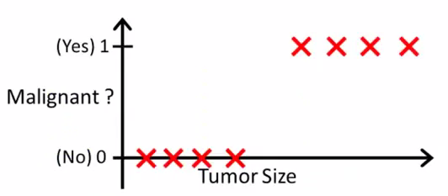
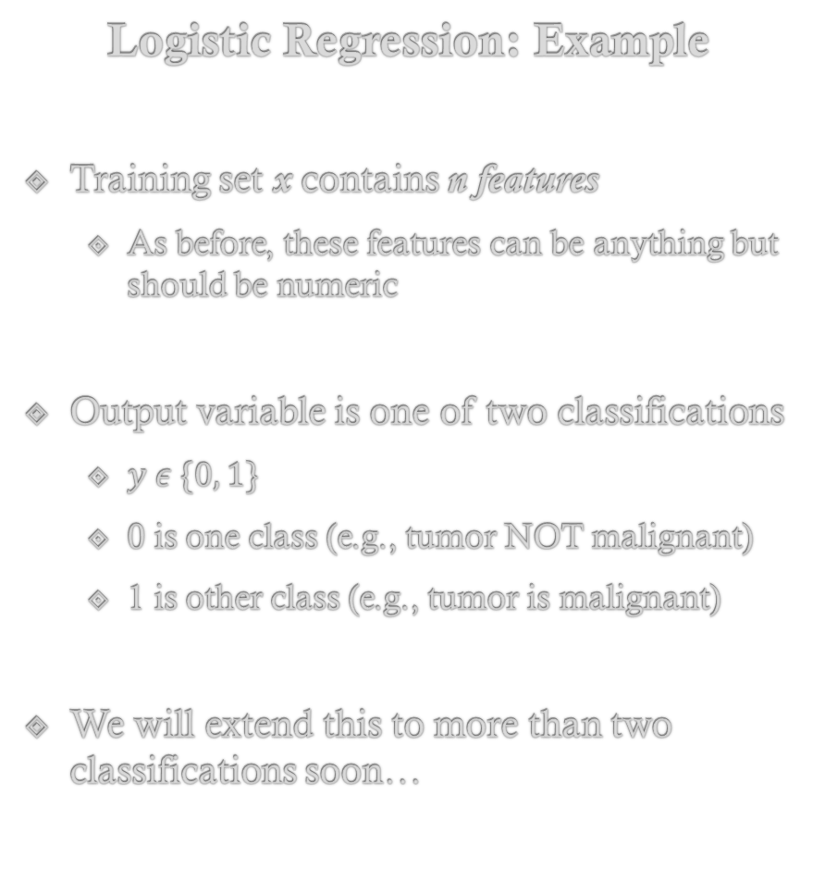
Logistic Regression: Example
Training set x contains n features
As before, these features can be anything but should be numeric
Output variable is one of two classifications
$y ε \{0, 1\}$
0 is one class (e.g., tumor NOT malignant)
1 is other class (e.g., tumor is malignant)
We will extend this to more than two classifications soon…

Slide 34
Logistic Regression: Example
As before, we want to fit a curve to this data
However, a linear fit doesn’t make any sense, so what curve can we fit here?
What might happen if we do fit a line to this data? What if there are some outliers?
…hint: it is one of our old friends!

Slide 35
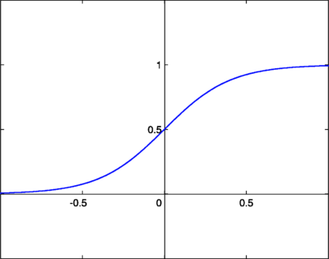
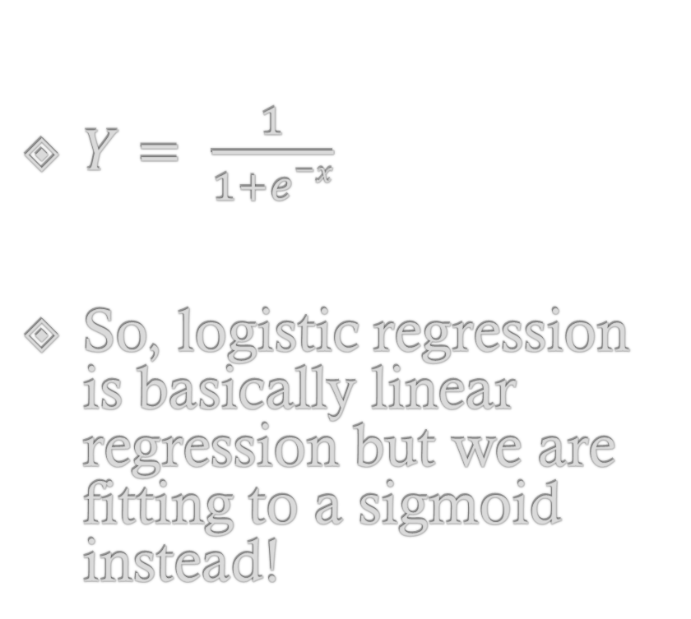
The Sigmoid Function!
$Y= \frac{1}{1+e−x}$
So, logistic regression is basically linear regression but we are fitting to a sigmoid instead!

Slide 36
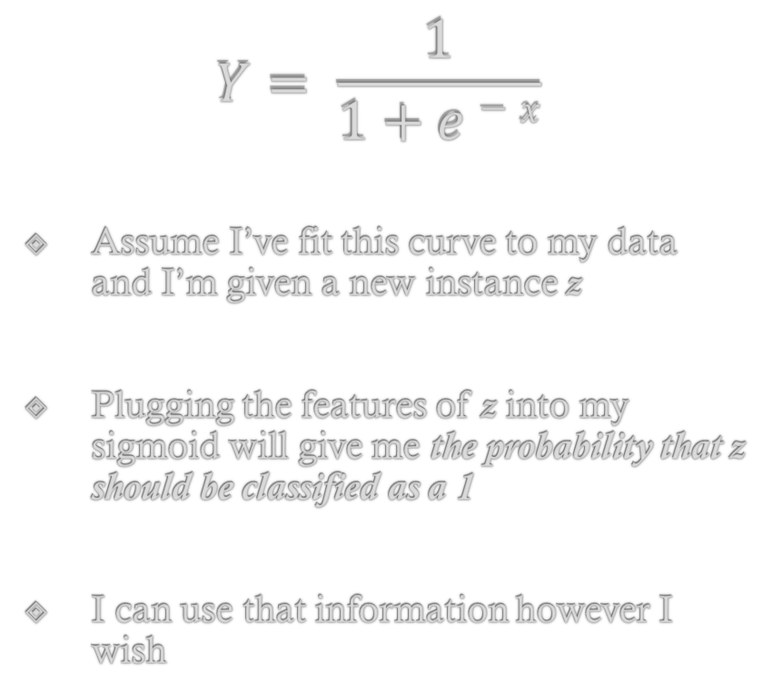
Interpreting the Sigmoid Function!
$$Y= \frac{1}{1+e−x}$$
Assume I’ve fit this curve to my data and I’m given a new instance z
Plugging the features of z into my sigmoid will give me the probability that z should be classified as a 1
I can use that information however I wish

Slide 37
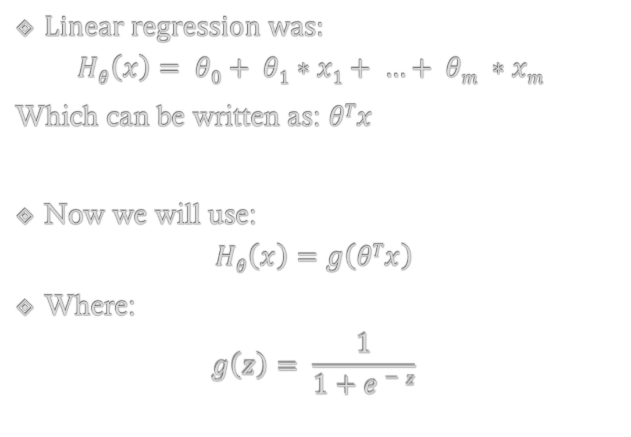
Logistic Regression: Hypothesis Function
Linear regression was:
$$Hθ\left(x\right)= θ0+ θ1∗x1+ …+ θm ∗xm$$
Which can be written as: $θTx$
Now we will use:
$$Hθ\left(x\right)=g\left(θTx\right)$$
Where:
$$g\left(z\right)= \frac{1}{1+e−z}$$

Slide 38
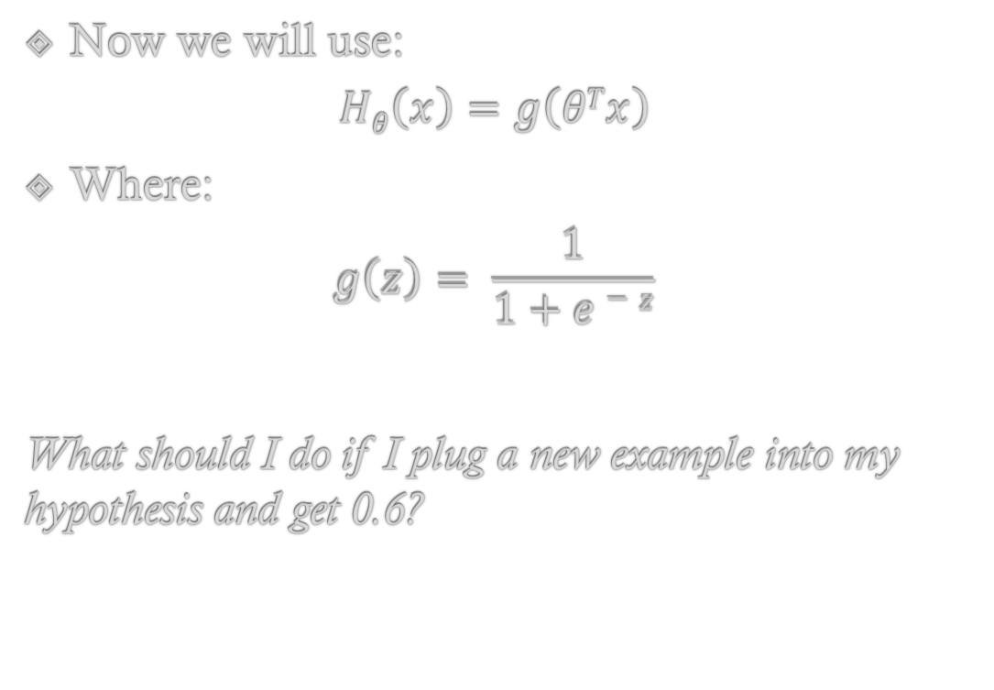
Logistic Regression: Hypothesis Function
Now we will use:
$$Hθ\left(x\right)=g\left(θTx\right)$$
Where:
$$g\left(z\right)= \frac{1}{1+e−z}$$
What should I do if I plug a new example into my hypothesis and get 0.6?

Slide 39
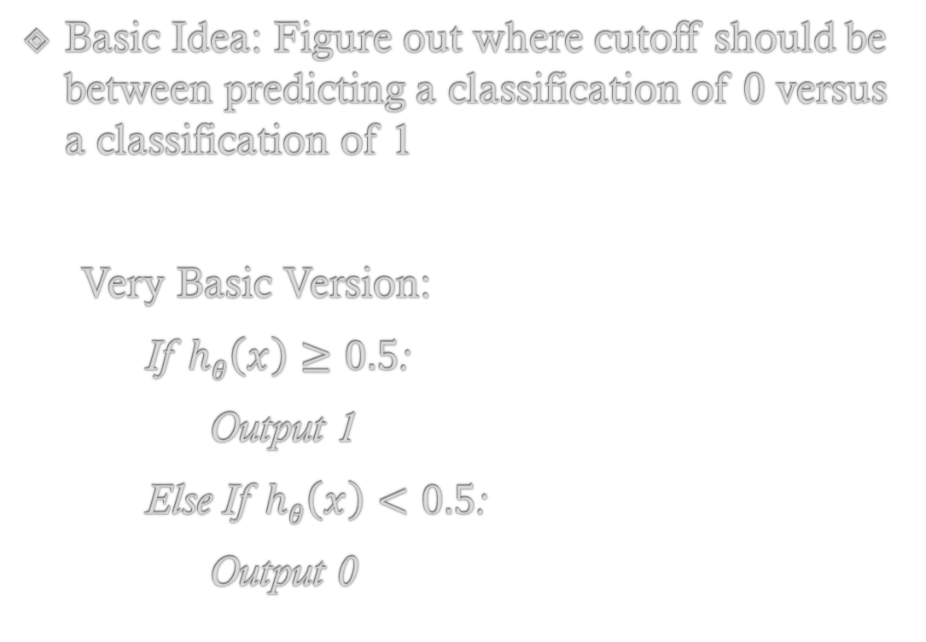
Logistic Regression: Decision Boundary
Basic Idea: Figure out where cutoff should be between predicting a classification of 0 versus a classification of 1
Very Basic Version:
If $hθ\left(x\right)≥0.5$:
Output 1
Else If $hθ\left(x\right)<0.5$:
Output 0

Slide 40
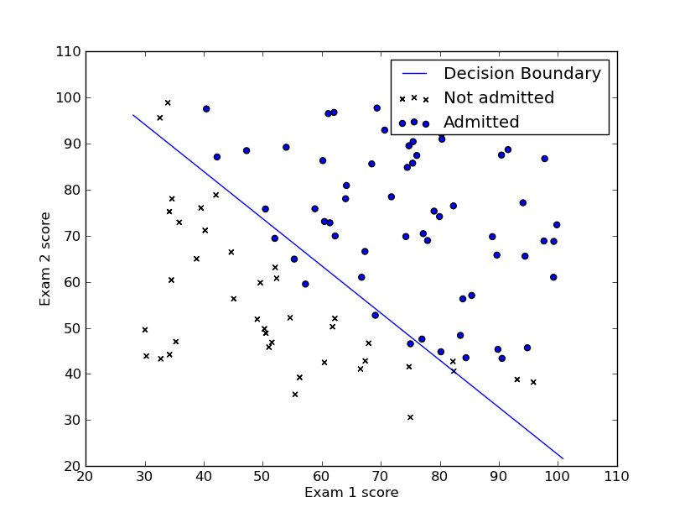
Logistic Regression: Decision Boundary
Because we are passing a linear function into our sigmoid, our decision boundary looks like this
Assumes two features were used
So an input that falls directly on this line will result in exactly 0.5 being output from the sigmoid!
Intuitive, the line separates the two classifications

Slide 41
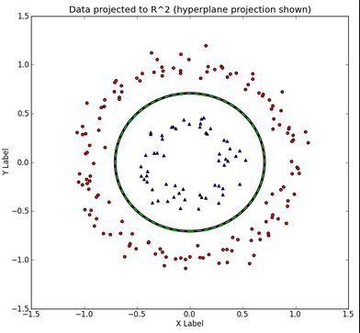
Logistic Regression: Decision Boundary
But what if our data points look like this!?
No line does a good job of splitting these classifications!
Need a new function to use as input to our sigmoid!!

Slide 42
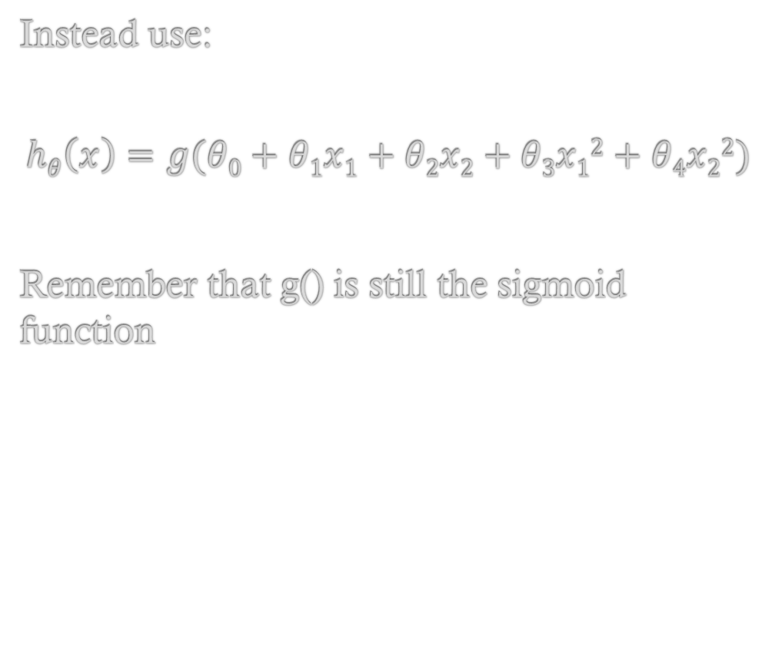
Logistic Regression: Decision Boundary
Instead use:
$$hθ\left(x\right)=g(θ0+θ1x1+θ2x2+θ3x12+θ4x22)$$
Remember that g() is still the sigmoid function

Slide 43
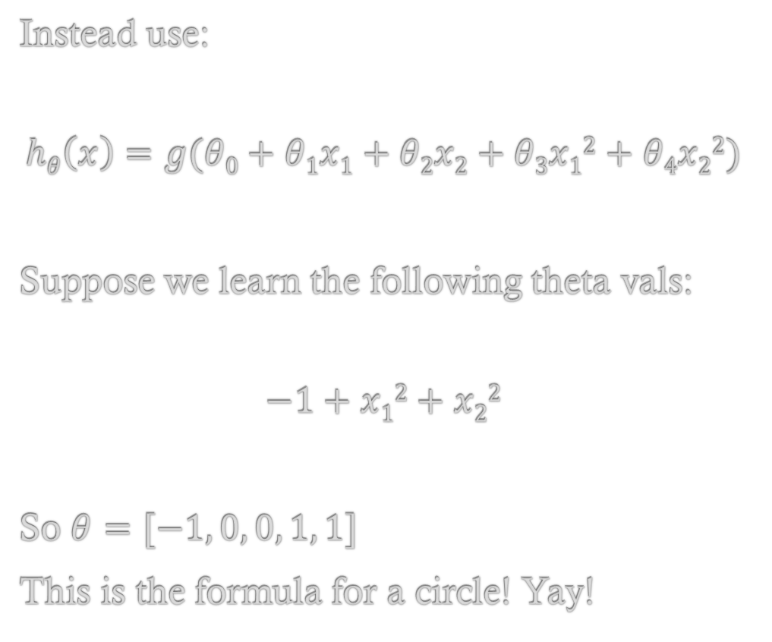
Logistic Regression: Decision Boundary
Instead use:
$$hθ\left(x\right)=g(θ0+θ1x1+θ2x2+θ3x12+θ4x22)$$
Suppose we learn the following theta vals:
$$−1+x12+x22$$
So $θ=[−1, 0, 0, 1, 1]$
This is the formula for a circle! Yay!

Slide 44
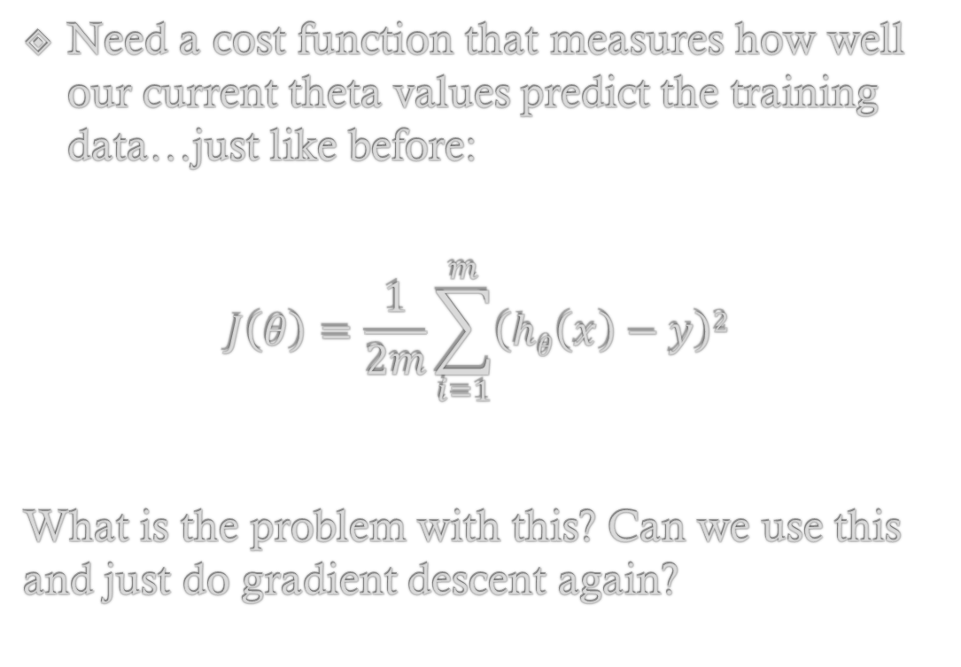
Logistic Regression: Cost Function
Need a cost function that measures how well our current theta values predict the training data…just like before:
$$J\left(θ\right)=\frac{1}{2m}\sum_{i=1}^{m}{\left(hθ\left(x\right)−y\right)2}$$
What is the problem with this? Can we use this and just do gradient descent again?

Slide 45
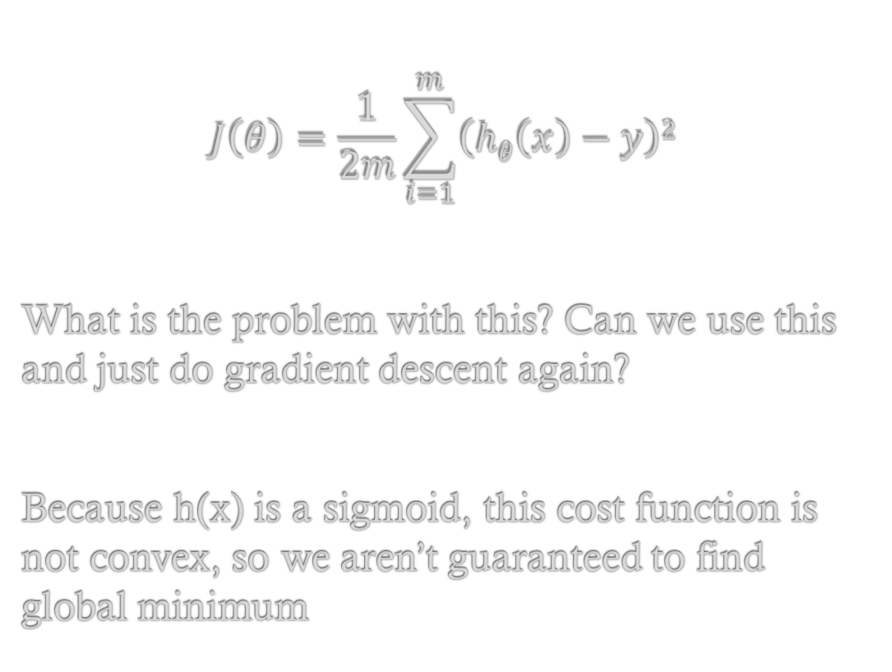
Logistic Regression: Cost Function
$$J\left(θ\right)=\frac{1}{2m}\sum_{i=1}^{m}{\left(hθ\left(x\right)−y\right)2}$$
What is the problem with this? Can we use this and just do gradient descent again?
Because h(x) is a sigmoid, this cost function is not convex, so we aren’t guaranteed to find global minimum

Slide 46
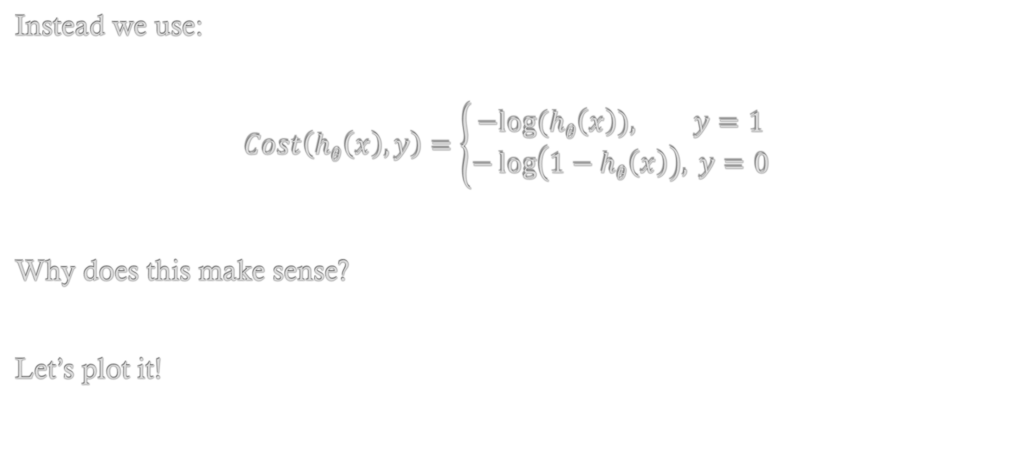
Logistic Regression: Better Cost Function
Instead we use:
$$Cost\left(hθ\left(x\right), y\right)=\left\{\begin{aligned}−&log⁡(hθ\left(x\right)), y=1 \\ −\log\left(1−hθ\left(x\right)\right), y=0\end{aligned}\right.$$
Why does this make sense?
Let’s plot it!

Slide 47
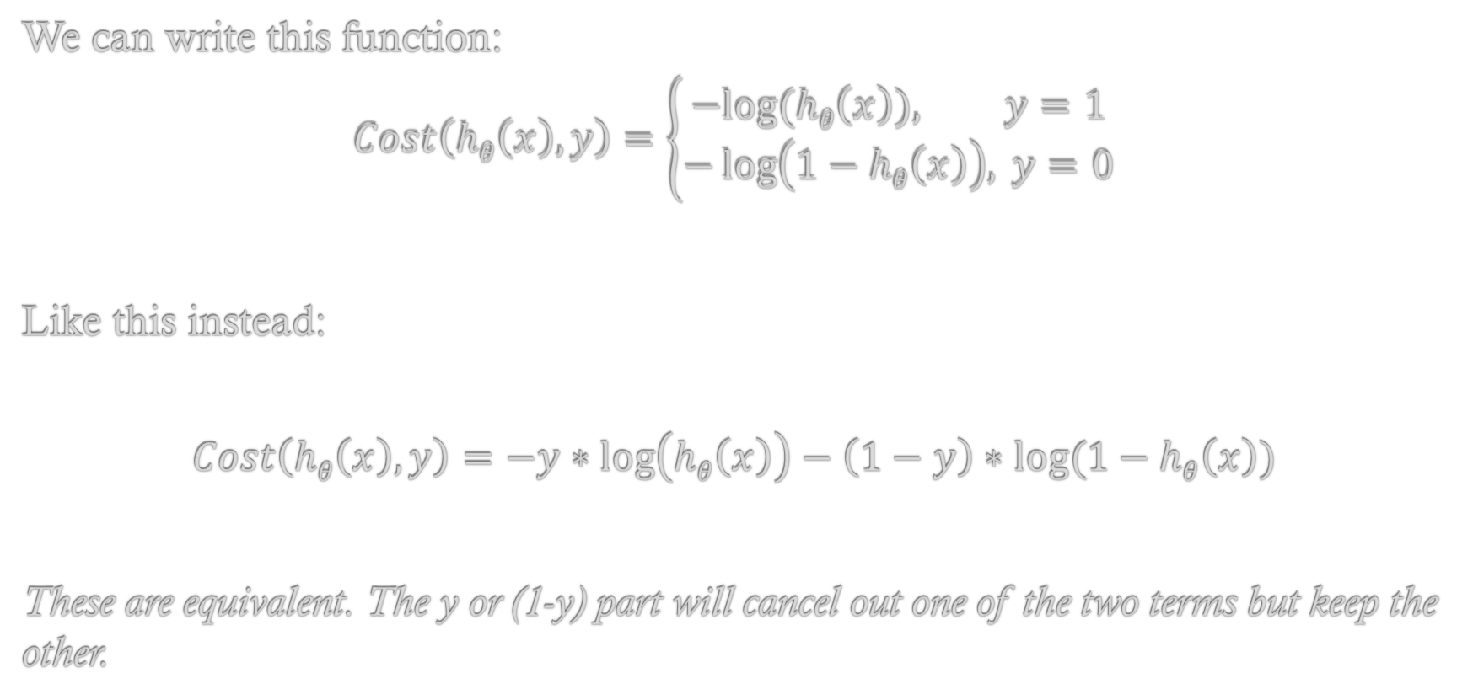
Logistic Regression: Better Cost Function
We can write this function:
$$Cost\left(hθ\left(x\right), y\right)=\left\{\begin{aligned}−&log⁡(hθ\left(x\right)), y=1 \\ −\log\left(1−hθ\left(x\right)\right), y=0\end{aligned}\right.$$
Like this instead:
$$Cost\left(hθ\left(x\right), y\right)=−y∗\log\left(hθ\left(x\right)\right)−\left(1−y\right)∗log⁡(1−hθ\left(x\right))$$
These are equivalent. The y or (1-y) part will cancel out one of the two terms but keep the other.

Slide 48
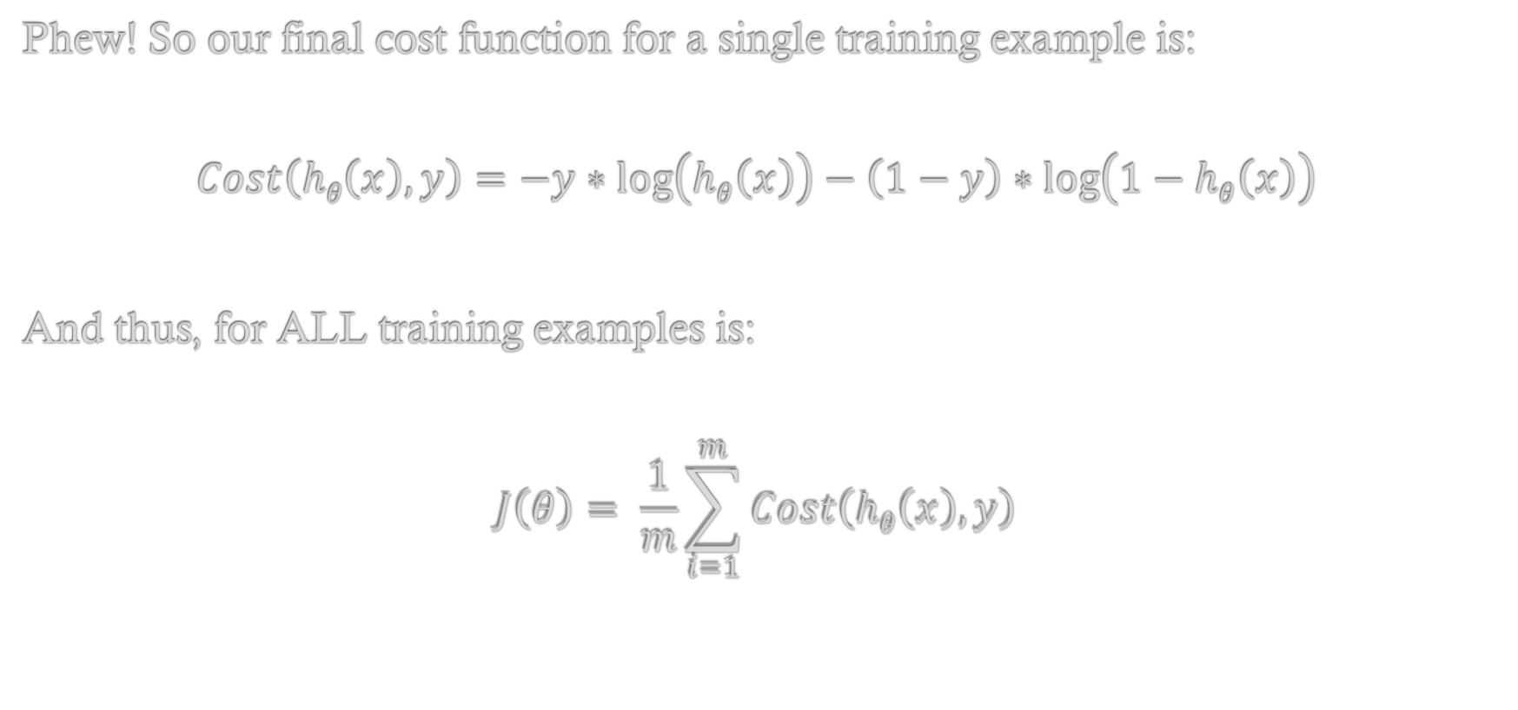
Logistic Regression: Better Cost Function
Phew! So our final cost function for a single training example is:
$$Cost\left(hθ\left(x\right), y\right)=−y∗\log\left(hθ\left(x\right)\right)−\left(1−y\right)∗\log\left(1−hθ\left(x\right)\right)$$
And thus, for ALL training examples is:
$$J\left(θ\right)= \frac{1}{m}\sum_{i=1}^{m}{Cost\left(hθ\left(x\right), y\right)}$$

Slide 49
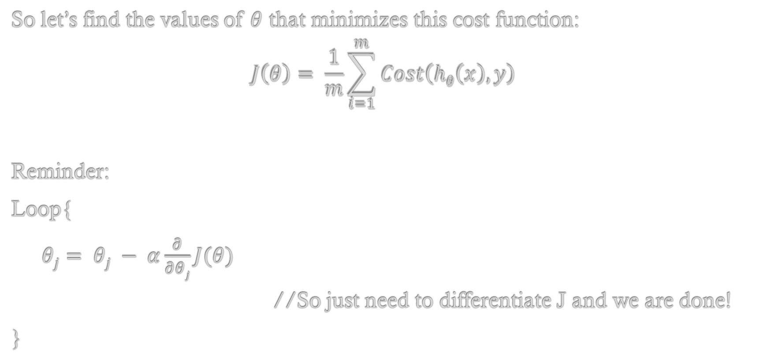
Logistic Regression: Gradient Descent
So let’s find the values of $θ$ that minimizes this cost function:
$$J\left(θ\right)= \frac{1}{m}\sum_{i=1}^{m}{Cost\left(hθ\left(x\right), y\right)}$$
Reminder:
Loop{
$θj= θj − α\frac{∂}{∂θj}J(θ)$
//So just need to differentiate J and we are done!
}

Slide 50
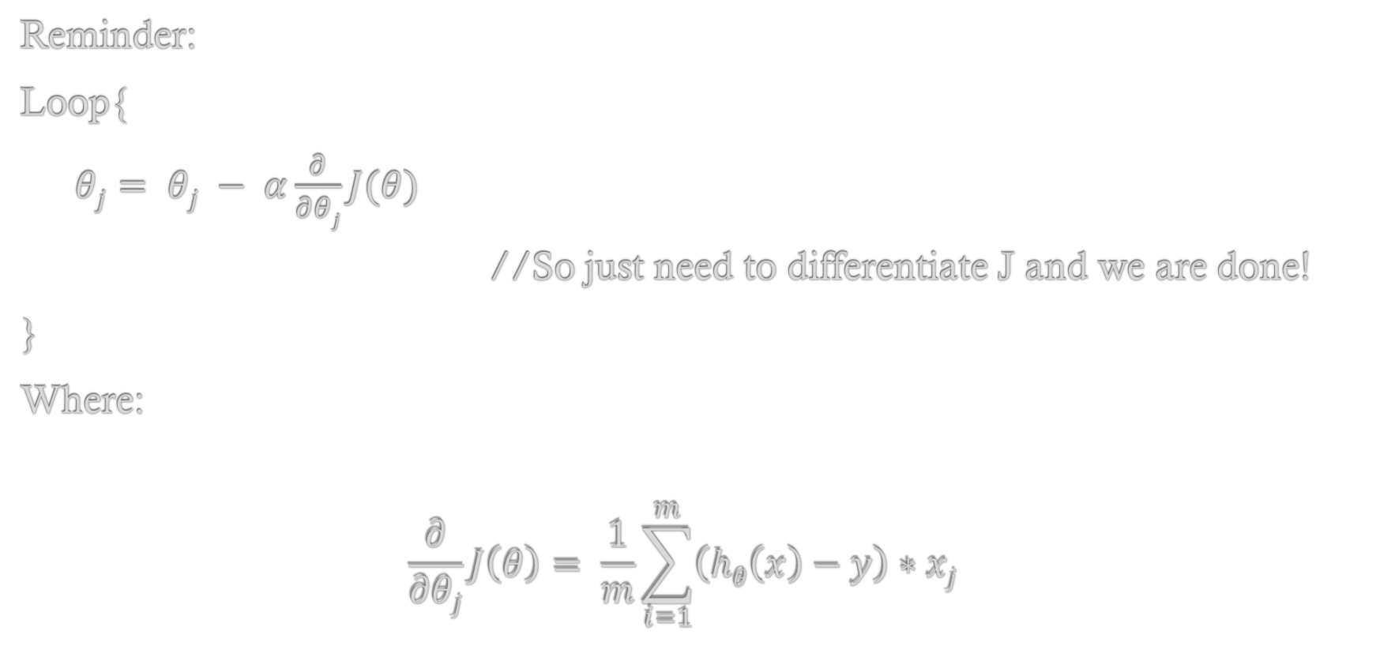
Logistic Regression: Gradient Descent
Reminder:
Loop{
$θj= θj − α\frac{∂}{∂θj}J(θ)$
//So just need to differentiate J and we are done!
}
Where:
$$\frac{∂}{∂θj}J\left(θ\right)= \frac{1}{m}\sum_{i=1}^{m}{\left(hθ\left(x\right)−y\right)∗xj }$$

Slide 51
Logistic Regression
Multi-class classification

Slide 52
Multi-Class Classification!
Problem: Doing classification but there is more than one class!
Before we had 0 and 1
But we could have 0-5 or anything else!
How can we adapt logistic regression to handle this?

Slide 53
Many vs. One Algorithm!
One way to deal with this is called the many versus one algorithm
Suppose we have 5 classifications (1-5)
Idea:
Treat 1 as a 1 and 2-5 as 0
Run LR as we did before
Then, Treat 2 as 1 and 1,3,4,5 as 0
Run another LR

Slide 54
Many vs. One Algorithm!
One way to deal with this is called the many versus one algorithm
Suppose we have 5 classifications (1-5)
Idea:
Treat 1 as a 1 and 2-5 as 0
Run LR as we did before
Then, Treat 2 as 1 and 1,3,4,5 as 0
Run another LR

Slide 55
Many vs. One Algorithm!
So, we end up with (in this case) five unique logistic regressions!
1 vs 2-5 //Will return the percent chance an example is a 1 or something else
2 vs 1,3-5 //Will return the percent chance an example is a 2 or something else
3 vs 1,2,4,5 //…3 or something else
4 vs 1-3,5 //…4 or something else
5 vs 1-4 //…5 or something else

Slide 56
Many vs. One Algorithm!
So, we end up with (in this case) five unique logistic regressions!
1 vs 2-5 //Will return the percent chance an example is a 1 or something else
2 vs 1,3-5 //Will return the percent chance an example is a 2 or something else
3 vs 1,2,4,5 //…3 or something else
4 vs 1-3,5 //…4 or something else
5 vs 1-4 //…5 or something else
So, if we send an example through each regression it might return something like:
1: 0.2 2: 0.4 3: 0.81 4: 0.46 5: 0.33

Slide 57
Many vs. One Algorithm!
So, if we send an example through each regression it might return something like:
1: 0.2 2: 0.4 3: 0.81 4: 0.46 5: 0.33
In this case we would return that this example is a 3 because that is the highest percentage we calculated
Usually, we return the percentage as well (as a degree of confidence measure)

Slide 58
Summary

Slide 59
Conclusions!
Supervised Learning: Given training examples, learn to recognize patterns and identify new unseen instances of the same kind
Version Space Learning:
Simple, easy to code, good for Boolean data only
Not terribly useful unless training set is quite simple
Decision Tree Induction
Simple to understand (CS people love trees!), easy to code, easy to adapt to new datasets
May need to tweak how tree is built so that you learn the best tree possible

Slide 60
Conclusions!
Supervised Learning: Given training examples, learn to recognize patterns and identify new unseen instances of the same kind
Regression:
Really strong, general technique for learning. Good for almost any data set with continuous output variable. Can use Normal Equation or Gradient Descent. Can be adapted to fit polynomials, normalized for simplification, etc. very easily
Not as sophisticated as some approaches we’ll see later (Neural Networks etc.)
Logistic Regression:
Great for classification tasks (output variable is discreet). Naturally probabilistic. Same cost function (in form) as linear regression. Can handle multiple classes quite easily

